Slide 1
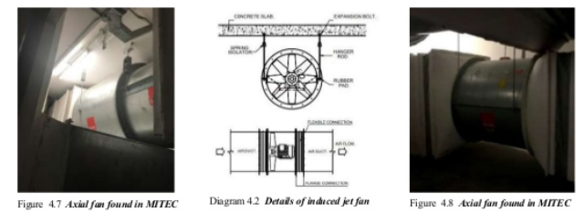
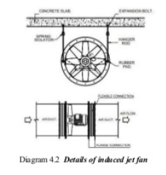
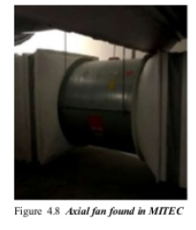
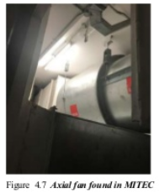
AXIAL FAN
AN AXIAL FAN CONSISTS OF AN IMPELLER WITH BLADES OF AEROFOIL SECTION ROTATING INSIDE CYLINDRICAL CASING TO INCREASE THE PRESSURE OF THE AIR FLOWING
AXIAL FANS ARE USED FOR RELATIVELY HIGH FLOW RATETO HELP IN
BETTER AIR QUALITY WITHIN ENCLOSED SPACE
LOCATED AT THE FAN ROOMS AT BASEMENT.

Slide 2
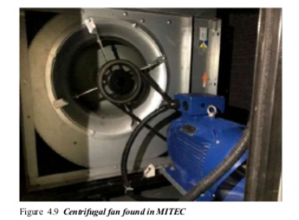
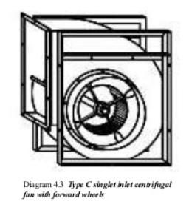
CENTRIFUGAL FAN
FAN USED IN MITEC IS PRODUCT MANUFACTURED BY KRUGER
IT IS SINGLET INLET CENTRIFUGAL FAN WITH FORWARD WHEELS
IT HAS FRAME FITTED ON BOTH SIDE OF THE FAN WHICH GIVES BETTER STRENGHT & RIGIDITY & ALLOWS MOUNTING IN FOUR DIFFERENT ORIENTATION
THIS FANS OPERATES AGAINTS HIGH RESISTANCE BY CENTRIFUGH FORCE

Slide 3
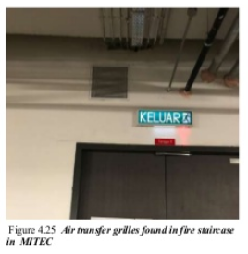
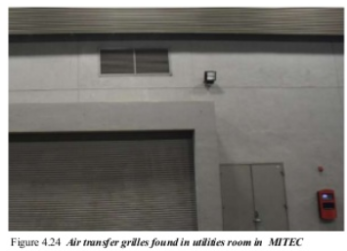
AIR TRANSFER GRILLE
AIR TRANSFER GRILLE ARE INSTALLED IN THE WALL TO CONNECT ENCLOSED ROOM WITH OPEN SPACE
THEREFORE PROVINDING ADDITIONAL PATHWAYS FOR AIR MOVEMENT & YET MAINTAINING THE INTERGRITY OF WALL DURING A FIRE SITUATION

Slide 4
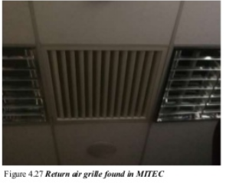
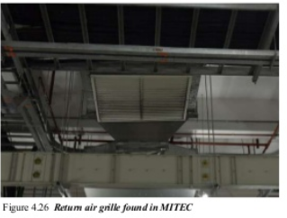
CEILING MOUNTED RETURN AIR GRILLE
RETURN AIR IS A VENT GRILLE THAT IS LOCATED HALLWAY OR IN THE CEILING.
ITS PURPOSE IS TO EXTRACT AIR FORM ROOM AND RECYCLE IT THROUGH THE SYSTEM TO FURTHER CONDITION IT BY COOLING OR HEATING.

